Slide 1
Syntax and logical error
Original Source :
http://www.ftsm.ukm.my/zma/TK1914/05-Algorithms and Problem Solving.ppt

Slide 2
SYNTAX ERRORS
Syntax errors are errors in the source code which are related to the syntax of the language.
Syntax errors are detected by the compiler. An executable file will be generated by the compiler only if the source code it compiles has no syntax errors.
Syntax errors are reported by the compiler in the form of error messages.

Slide 3
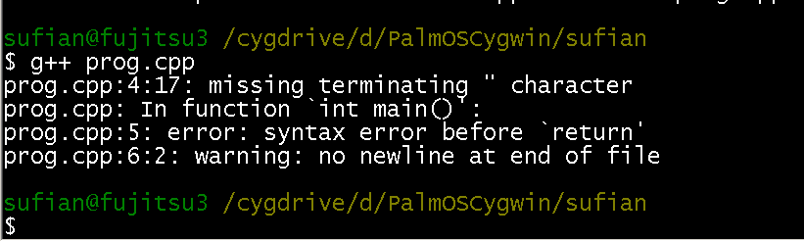
#include <iostream>
using namespace std;
int main() {
cout << "This program has errors
return;
}
Error messages displayed by the compiler

Slide 4
LOGICAL ERRORS
Logical errors are errors which are related to program logic.
Normally, logical errors are not detectable by the compiler.
Logical errors are usually detected during program runtime. For example, a program producing unexpected results is an indication that it has logical errors.
It is important to remember that if the compiler does not produce any error messages, it does not mean that your program is free of logical errors.

Slide 5
LOGICAL ERRORS
Possible to remove all syntax errors in a program and still not have it run
Even if it runs, it may still not do what you meant it to do
For example,
2 + 3 * 5 and (2 + 3) * 5
are both syntactically correct expressions, but have different meanings

Slide 6
Write a program to calculate the area of the region in blue.
#include <iostream>
using namespace std;
int main() {
float radius, length, width;
cout << "Enter radius, length and width: ";
cin >> radius >> length >> width;
cout << "Area of blue region: " << length * width - 3.14*radius*radius;
return 0;
}
Notes:
Example of logical error

Slide 7
Suppose we test the program with these inputs:
radius: 7 length: 2 width: 3
Area of circle = 3.14 * 7 * 7 = 153.86
Area of rectangle = 2 * 3 = 6
This means that the rectangle is enclosed by the circle. The area of the region should not be negative.

Slide 8
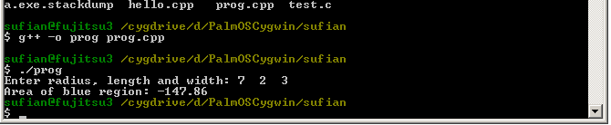
The following output is generated when the program is executed with those inputs.
The program should be checked for logical errors.

Slide 9
#include <iostream>
using namespace std;
int main() {
float radius, length, width;
cout << "Enter radius, length and width: ";
cin >> radius >> length >> width;
cout << "Area of blue region: "
<< length*width - 3.14*radius*radius;
return 0;
}
The formula should be
3.14*radius*radius – length*width
Notes:
Example of logical error

